Slide 1
An Introduction to Autistic Spectrum Conditions (ASC) – Level 1
Tom Connor
Educational Psychology Service

Slide 2
Programme Framework
Part 1: Understanding Autism
Part 2: Interpreting Communication
Part 3: Sensory Experiences
Part 4: Behaviour Analysis and strategy planning

Slide 3
What is Autism?
What do we think?
In pairs/ small groups
What we think Autism/ ASD/ ASC is
What our experiences have been supporting children on the autistic spectrum or with social communication weaknesses

Slide 4
Unpicking the Myths and Facts
Activity

Slide 5
What is Autism?
“Autism is a lifelong developmental disability that affects how a person communicates with, and relates to, other people. It also affects how they make sense of the world around them.”
(NAS, accessed September 2016)

Slide 6
A is for Autism …
… an 11 minute
“celebration of optimism for and by autistic people”

Slide 7
What is Autism?
It is described as:
A spectrum condition
A pervasive developmental disorder
It has three aspects
biological
cognitive
behavioural

Slide 8
What is Autism?
What causes Autism?
No single identifiable “cause” (… is it one single condition?)
Possibly a mixture of factors e.g.
Genetics – e.g. chromosomal disorders
allergic reactions
viral illness
distress in the womb or at birth
Not:
??? possible reaction to an injection ???

Slide 9
What is Autism?
Incidence rates
National Autistic Society (NAS) estimates
That in the UK:
Around 1 in 100 individuals may be on the autistic spectrum (1.1% of the population)
over 690,000 people estimated to have autism (an underestimation?)
4 out of every 5 children with autism are male

Slide 10
The Triad of Impairments
Social Interaction
Social Imagination /
Flexibility of thought
Social
Communication

Slide 11
The Autism Spectrum
A spectrum of conditions, sharing the underlying triad of behaviours
Autism and Asperger Syndrome are both autism spectrum disorders (… But DSM5)
People with ASC may move within the spectrum

Slide 12
Autism Spectrum
Social Interaction
Triad
Social Communication
Social Imagination /
Flexibility of thought

Slide 13
Social interaction
Experience difficulty with social relationships
May appear aloof and indifferent to other people
May enjoy certain forms of physical contact
Contact may appear odd, inappropriate and repetitive
Less ‘severe’ may passively accept social contact

Slide 14
Social communication
A continuum of difficulties from no language to a lot of speech, which they use to talk “at” others e.g. lack of:
Gesture, facial expression, tone of voice
Appreciation of the social uses of language
Understanding that language is a tool for conveying information

Slide 15
Imagination/ Flexibility of Thought
Difficulty in the development of play and
imagination
Limited range of imaginative activities, possibly copied and pursued rigidly and repetitively
Attending to minor or trivial aspects

Slide 16
ASC traits
Many individuals with an ASC have other traits, including differences in sensory processing
Each person with an ASC is an individual with areas of strength and weaknesses – just like all of us
“The neurotypical cave dwellers may have enjoyed partying in the cave mouth, but we also owe something to the person who persisted in banging the stones together at the back of the cave”
(Derbyshire File for Autism Friendly Schools)

Slide 17
ASC Strengths include…
An unusually good memory for facts
A focus on a narrow range of interests, meaning they are well informed on some topics
Skills in ICT, Maths, Science, technology
A determination to complete tasks to a high standard
Complying with rules (e.g. punctuality)
Honesty – even at the cost of social popularity

Slide 18

The Triangle Test
http://www.youtube.com/watch?v=xbRLorMbprU

Slide 19
Autism and Asperger Syndrome
See handout…
Any questions or things you’d like to discuss so far?

Slide 20
What is Communication?
Clip “Four Candles”
In pairs, what’s really going on here?

Slide 21
What is communication?
“the imparting or exchanging of information by speaking, writing, or using some other medium”
So: Why do we communicate?

Slide 22
Why do we communicate?
Examples might include:
To respond to someone else (“yes please”)
To request something we need (“a drink”)
To protest, refuse or complain (“no!”)
To think and plan (“I think we should…”)
To comment on something (“nice shirt, Tom”)
To give or seek information (“who are you?”
To share ideas or feelings (“I feel sad”)

Slide 23
Adjusting our communication
See activity sheet
What do we need to do to support young people on the autistic spectrum?
Think about both our expressive communication (what we say/ do) and our receptive skills (what we take in).

Slide 24
Adjusting our communication (1)
Reducing language
Encouraging eye contact (?)
Give time to process
Use the child’s name to get attention
Say things in the order they’ll happen

Slide 25
Adjusting our communication (2)
Use ‘then’ to help a child understand sequences
Give choices
Tell the child what to do (be positive)
Use visuals
Use ‘finished’ so the child knows a task is over

Slide 26
Quote
“In the past I used to ask the same questions over and over and I used to drive my parents crazy by doing that! I wanted to hear the same answer over and over because I was never sure of anything…….I wanted an exact answer to everything: uncertainty used to drive me crazy.”
(Paul McDonnell)

Slide 27
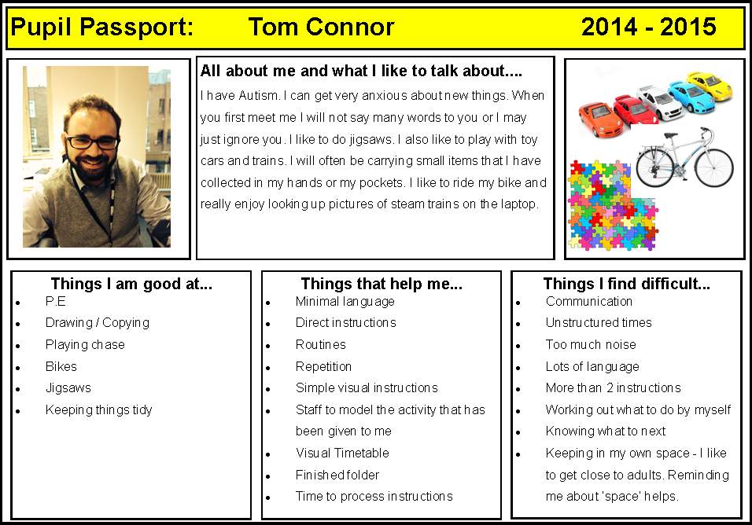
Visual approaches

Slide 28
Autism and the Senses
People with autism spectrum conditions often present unusual responses to sensory stimuli, such as light, sound, touch etc. If these sensory behaviours are not understood, then they can appear as challenging behaviour.

Slide 29
Autism and the Senses
“Turn on the radio, but do not tune it. Leave it on static and fuzz. Turn it up. Ask someone to turn the lights on and off. Strap yourself into a broken chair that is missing a leg and use a table that is off balance-you know the ones in restaurants that makes us all so mad. Now put on some scratchy lace in place of a comfortable T-shirt, put your pants on backwards and wear shoes one size too small. Pour a bowl of grated Parmesan cheese, open a can of sardines and bring the cat box to the table. Now snack on your least favourite food, the one you never eat because it comes with a gag reflex. With all this in place, pick up a new book and learn something new!”
(http://mywebpages.comcast.net/momtofive/SIDWEBPAGE2.htm#Integration)

Slide 30
Autism and the Senses – the 5 we know
System | Location | Function
Tactile (Touch) | Skin | Helps us to assess the environment we are in and enables us to react accordingly. It relates to touch, type of pressure, level of pain and distinguishing temperature.
Visual (Sight) | Retina of eye | Helps us to define objects, people, colours, contrast and spatial boundaries
Auditory (Hearing) | Inner ear | Informs us about sounds in the environment
Gustatory (Taste) | Chemical receptors in tongue | Informs us about different tastes – sweet, sour, bitter, salty, spicy. Can result in restricted diets as taste buds are extra sensitive.
Olfactory (smell) | Chemical receptors in nose | Informs us about smells in our immediate environment.

Slide 31
As well as…
System | Location | Function
Proprioceptive (body awareness) | Muscles and joints | Informs us where our bodies are in space and how they are moving.
Vestibular (balance) | Inner ear | Provides information on where our body is in space, its speed, direction and movement. It is fundamental in helping us to keep our balance and posture.

Slide 32
Sensory Experiences – Activity (H/O)
People with autism may show unusual responses to sensory experiences, particularly sound and touch, but also taste, vision, smell or pain. They may underreact or overreact to sensory stimuli, perceiving ordinary sensations as extremely intense or extremely weak. Even anticipation of sensations may produce anxiety or panic.

Slide 33
Sensory Processing
It is a normal neurological process that begins before we are born and continues throughout our lives.
It is the process by which our brain takes in all incoming information, processes it and organises appropriate responses.
Analogy: Heathrow Airport, with flights coming in from many directions and heights, being controlled by Air Traffic Controllers.

Slide 34
Sensory Modulation
Sensory modulation is “the ability to regulate and organise reactions to sensory input in a graded and adaptive manner” (McIntos, Miller, et al, 1999, p:10)
Autistic pupils may have difficulty in doing so in a typical manner, either over- or under-reacting to sensory stimuli.

Slide 35
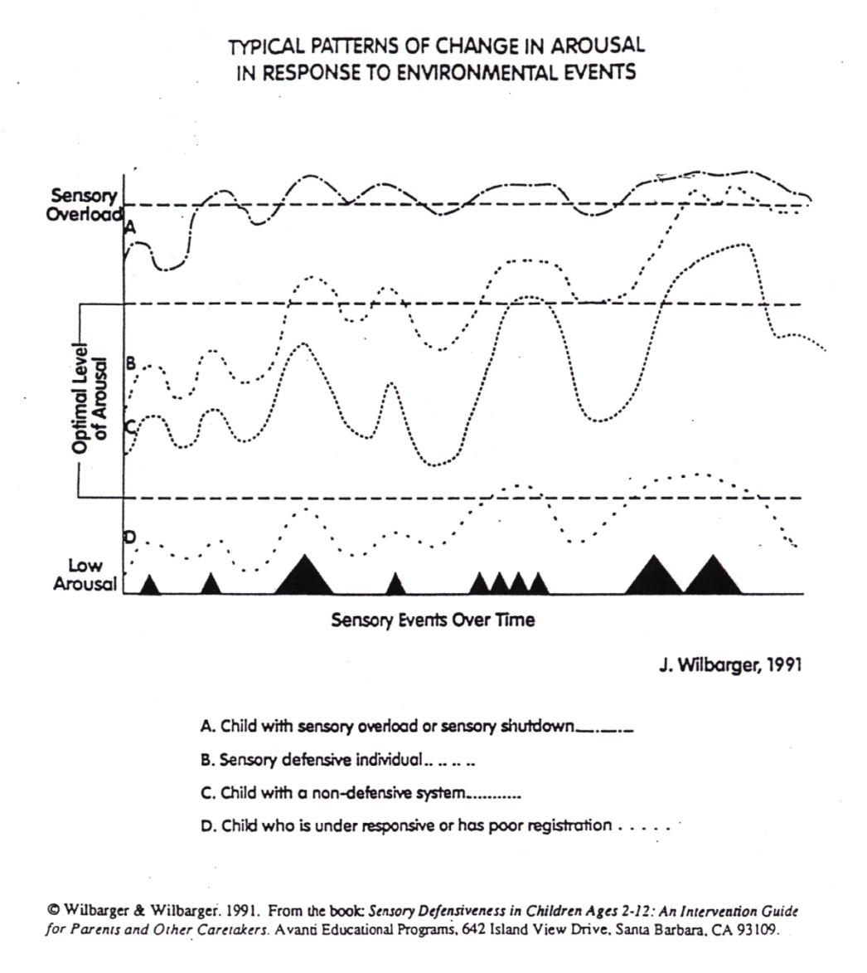
Response to environmental events
As a result, will struggle to differentiate between a quiet whisper and a loud bang.

Slide 36
Not listening?
“My hearing is like having a sound amplifier set on maximum loudness. My ears are like a microphone that picks up and amplifies sound. I have two choices: 1) turn my ears on and get deluged with sound or 2) shut my ears off.”
(Temple Grandin)

Slide 37
Sensory problems and ASC
Sensory experiences in action:
1. The Stroop Test
2. Synaesthesia

Slide 38
“Stroop” Test
Task: Do not read the words above. Instead, say the COLOUR of each word in each column, in a loud voice as fast as you can.
Directed Attention
Semantic Processing/ Interference

Slide 39
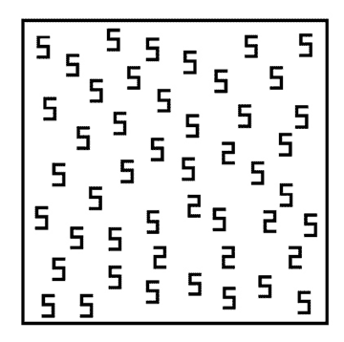
Synthaesthia
How quickly do you see the 2s among the 5s?

Slide 40
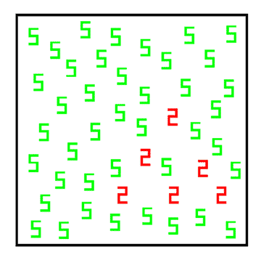
Synthaesthia

Slide 41
Theoretical Approaches
Theory of Mind
Central Coherence
And also:
Executive Functioning

Slide 42
Theory of Mind
“The ability to infer other people’s mental state (their thoughts, beliefs, intentions, etc.) and the ability to use this information to interpret what they say, make sense of their behaviour and predict what they will do next”
… The ‘toy in a drawer’ test

Slide 43
Theory of Mind
Portrayed by:
Insensitivity to other people’s feelings.
Inability to take into account what other people know.
Inability to understand the reasons behind people’s actions.
Inability to understand that language is used to convey intentions and express thoughts.
Inability to predict what will happen next.
Inability to deceive or understand deception.

Slide 44
Central Coherence
“The ability to integrate information in context”
“The ability to see the big picture, as opposed to getting lost in the smaller detail”

Slide 45
Central Coherence
“A clinician testing a bright autistic boy presented him with a toy bed, and asked the child to name the parts. The child correctly labelled the bed, mattress and quilt. The clinician then pointed to the pillow and asked “ And what is this?” The boy replied, “It’s a piece of ravioli”.”

Slide 46
Central Coherence
+ ve: privileged access to the parts of details that are normally left unnoticed due to being embedded in whole figures.
But: if attention is directed to smaller details, then context and meaning are likely to be missed or misunderstood.

Slide 47
Executive Functioning
“The conscious control of thought and action”
Poor planning
Poor impulse control
Disinhibition of predominant but incorrect responses
Disorganised search
Inflexibility of thought and action
Behaviour not directed to achieving goals.
Context inappropriate behaviour

Slide 48
Idioms
Smith’s Family Butcher
Bent out of shape
Ants in my pants
Catch 22
Grab the bull by the horns
Butterflies in my stomach
Feeling under the weather
Put two and two together
Keep your head above water
Loose lips sink ships
Pie in the sky
It’s raining cats and dogs
Fork in the road

Slide 49
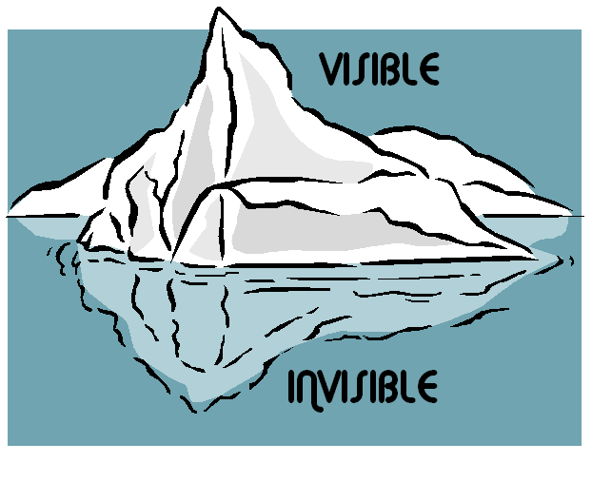
Iceberg model – understanding individual behaviour
The behaviour that we see is just the tip of the iceberg….we need to look below the surface to understand what the behaviour is telling us

Slide 50
Managing behaviour: ICEBERG analysis
Specific behaviour
“WHAT?”
Possible reason /
Communicative function
“WHY?”
The Iceberg Metaphor
(Schopler 1995)

Slide 51
Managing behaviour: ICEBERG analysis
e.g. angry outbursts
Specific behaviour
“WHAT?”
Possible reason /
Communicative function
“WHY?”
e.g. poor understanding of social rules
Unaware of others’ feeling
Hypo-sensitive to touch
Frustration over communication skills
Response to stressor (e.g. noise, smell)
The Iceberg Metaphor
(Schopler 1995)

Slide 52
Managing behaviour: ICEBERG analysis - activity
In small groups, talk about going to a crowded shopping centre:
Identify and describe some problem behaviours which a YP with autism might have going to the shops (put these in the top of the iceberg)
Identify and describe what might be some of the causes or underlying reasons for these problem behaviours (put these in the hidden part of the iceberg)
Be ready to share your ideas with the whole group

